Slide 1
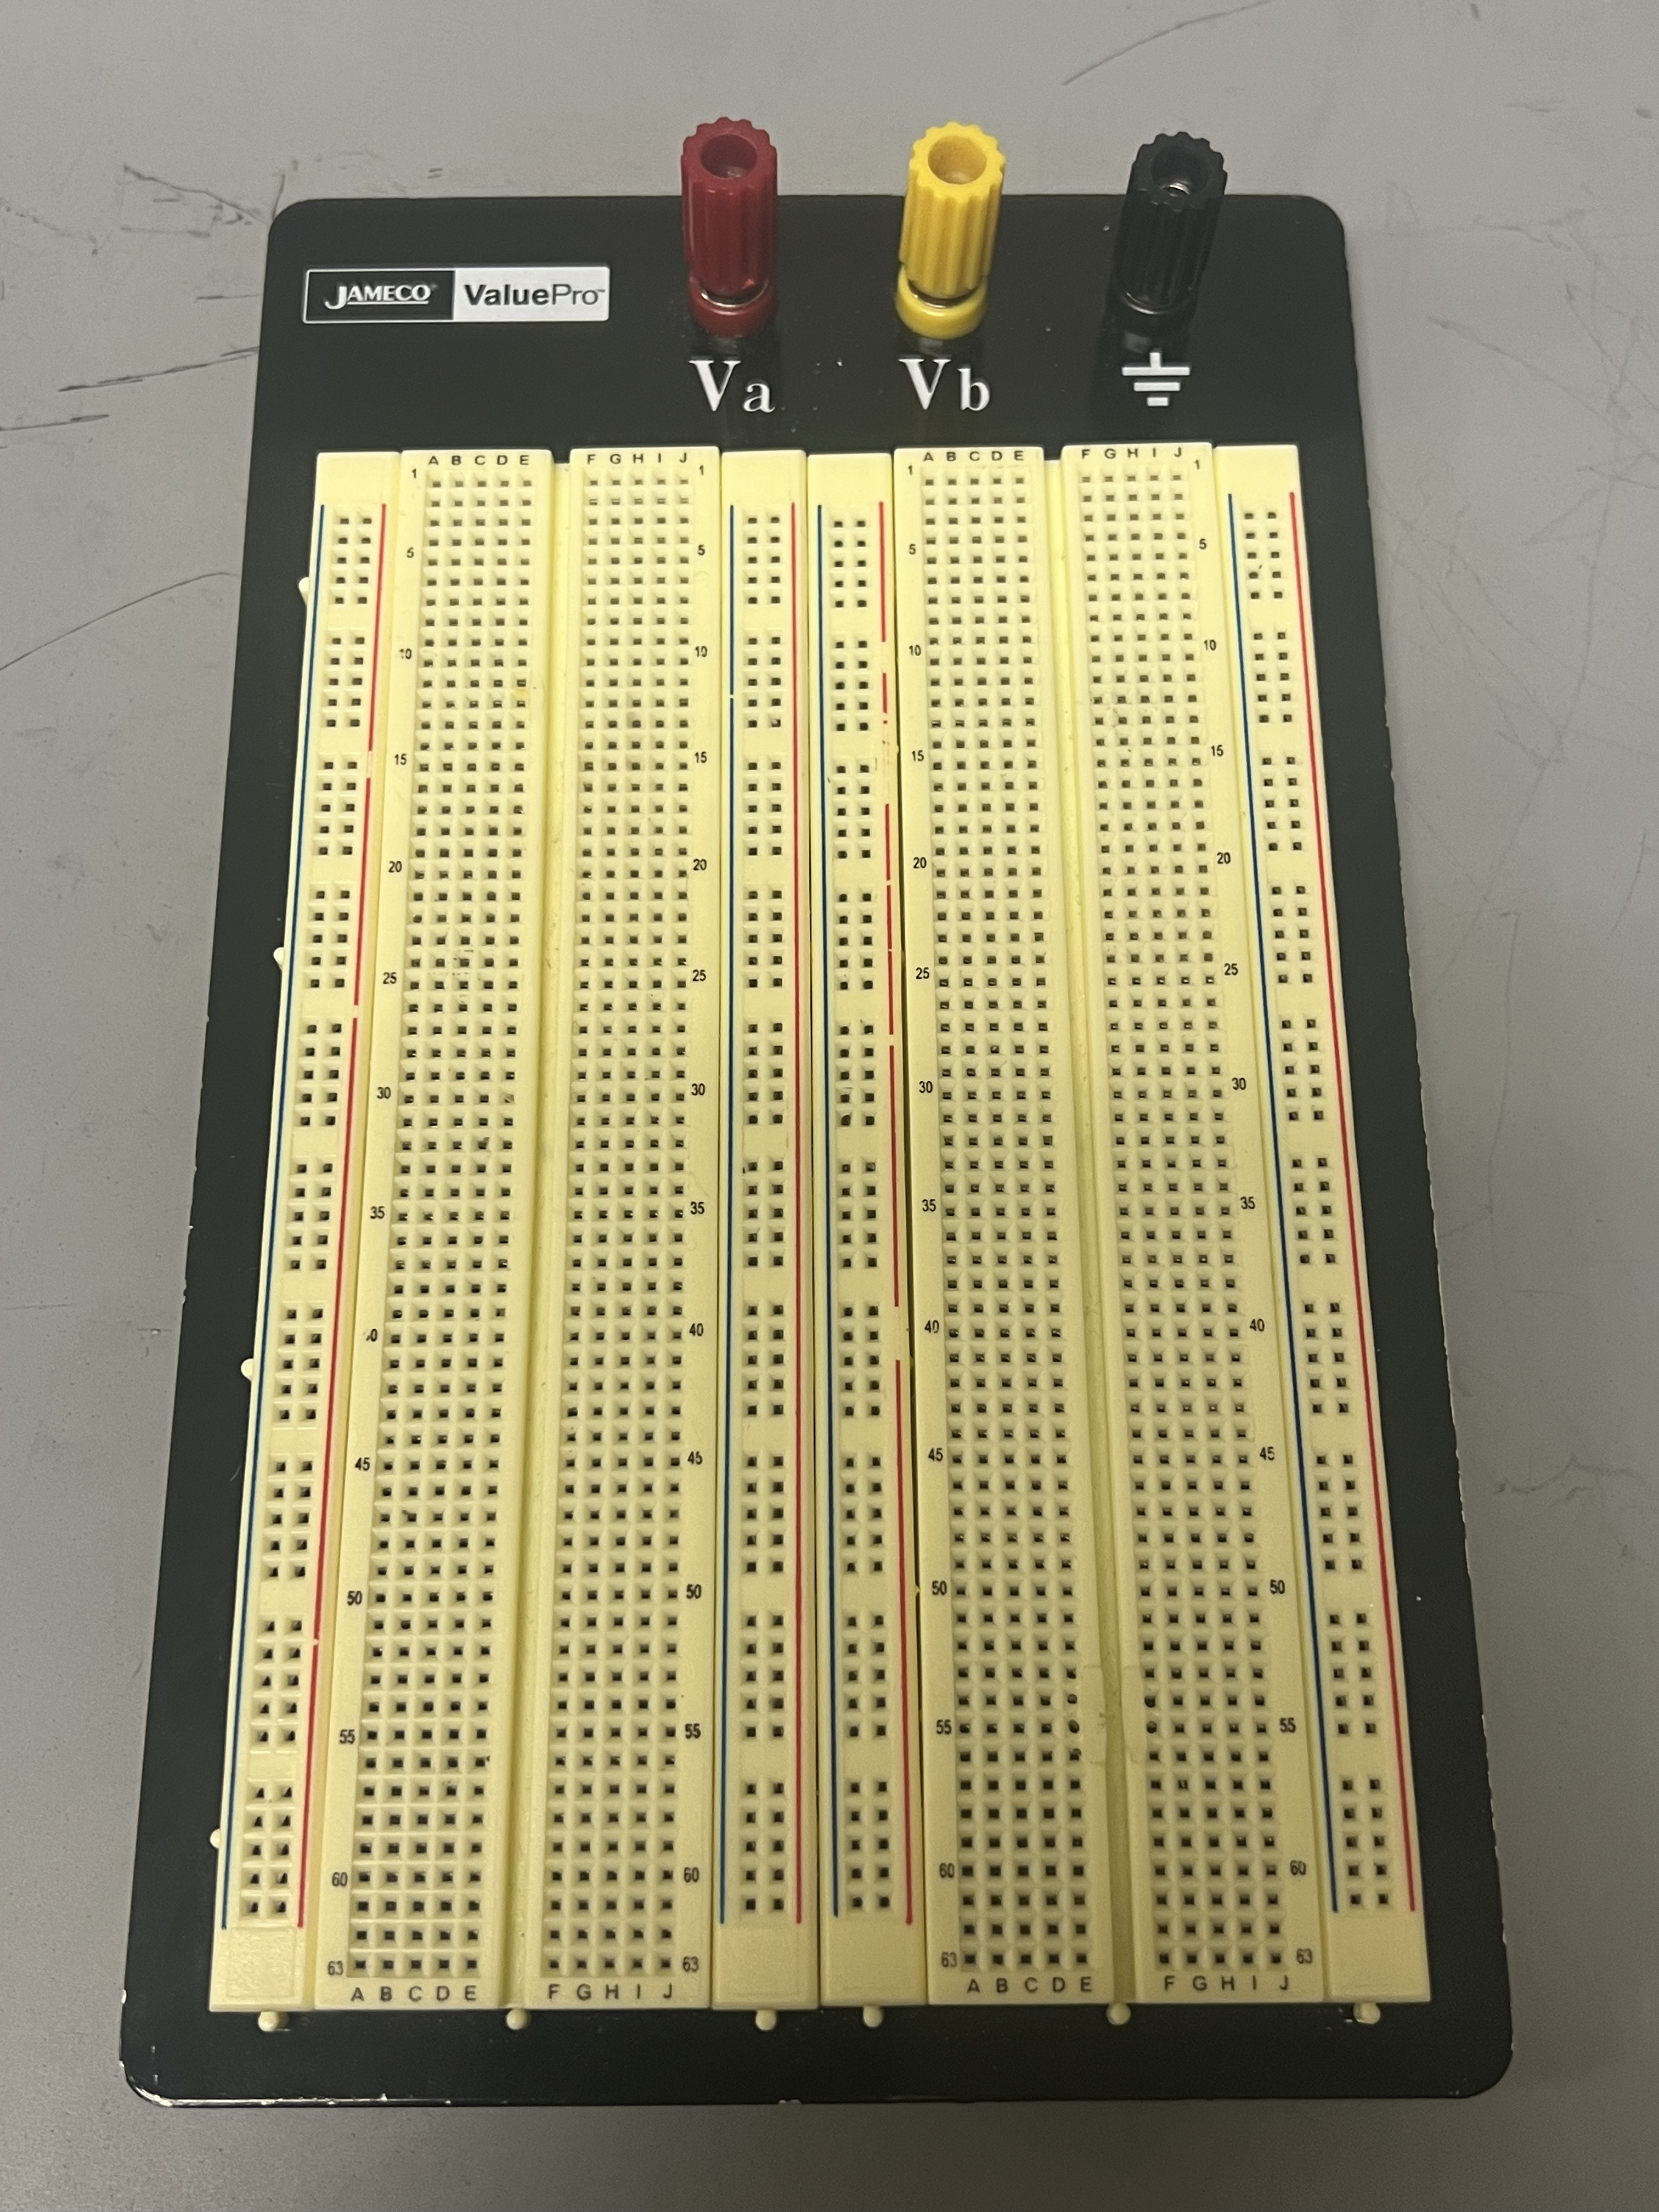
Well assembled breadboard

Slide 2
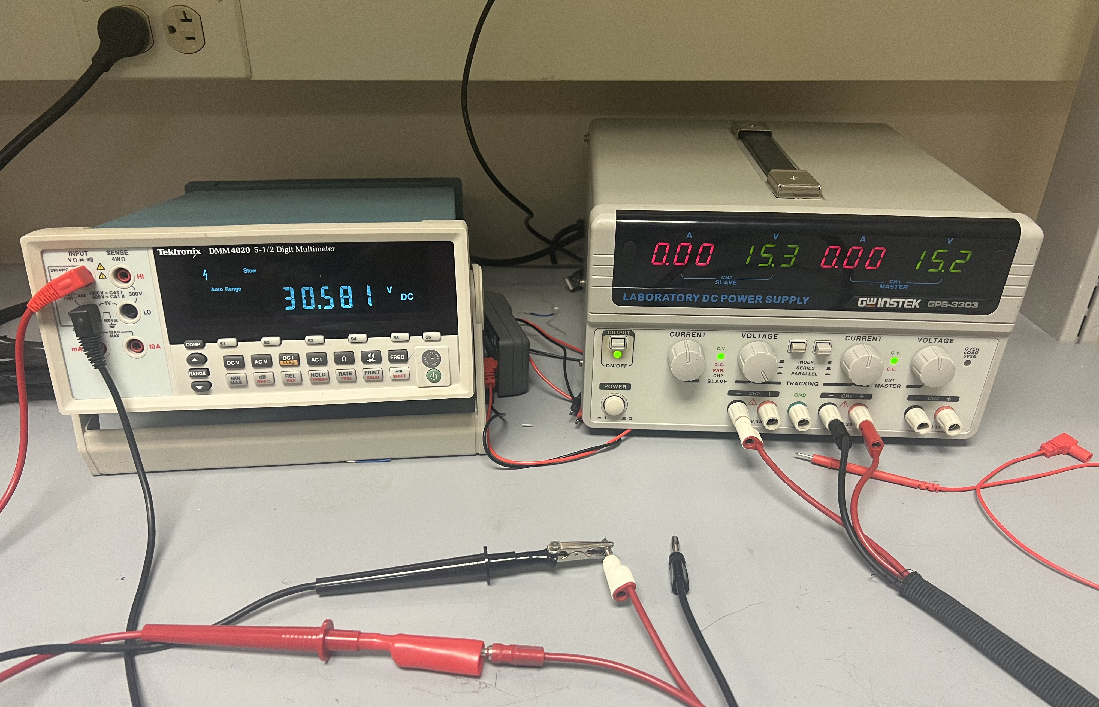
Multimeter Inputs
SERIES mode
CH1 Voltage
Switch
CH2 Voltage
Switch
DC Voltage Mode
CH1 Output
DC Current Mode
CH2 Output
Ohm Mode
Output Switch
Power Switch
Power Source and Multimeter

Slide 3
Example 1: Testing the connection of power source, and multimeter
Multimeter reading: CH1(+) – CH2(-)=(+15V) – (-15V) = 30V

Slide 4
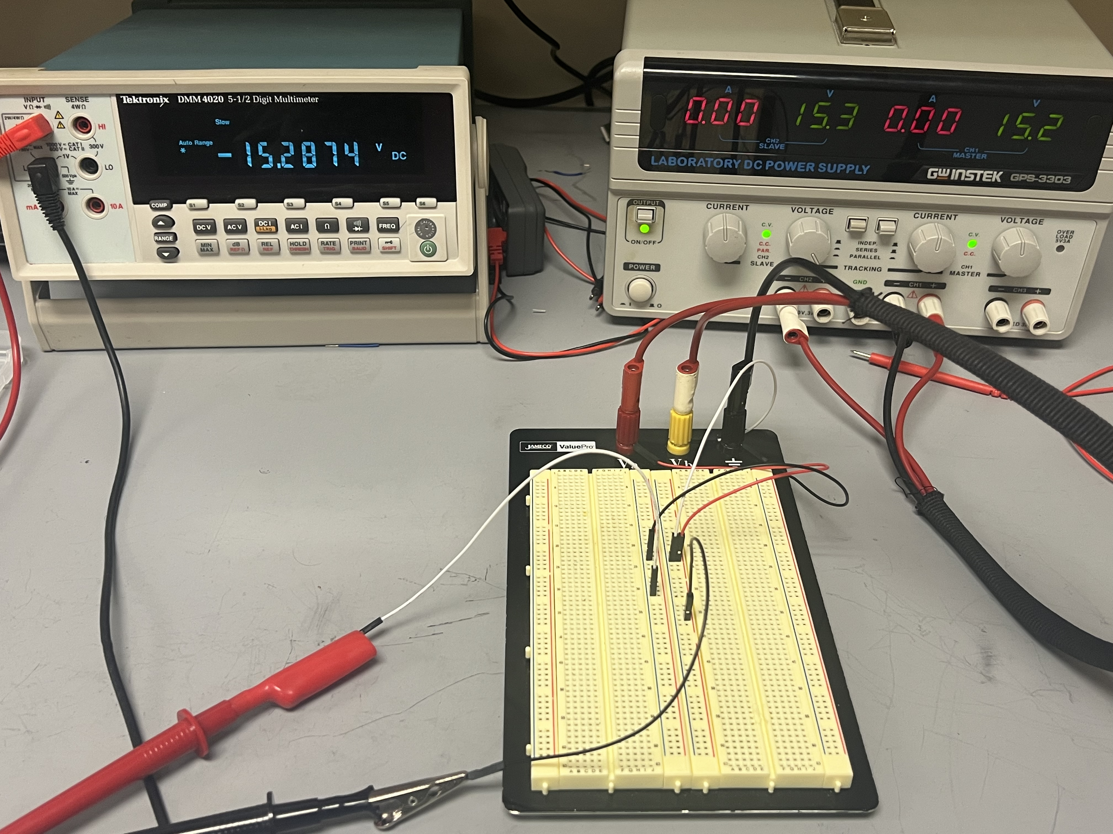
Example 2: Testing the connection of power source, breadboard, and multimeter
CH1(+) = 15V
CH1(-) = 0V
CH2(-) = -15V
Multimeter reading: CH1(-) – CH1(+) = (0V) – (+15V) = -15V
* Yellow hat is connected to the white wire

Slide 5
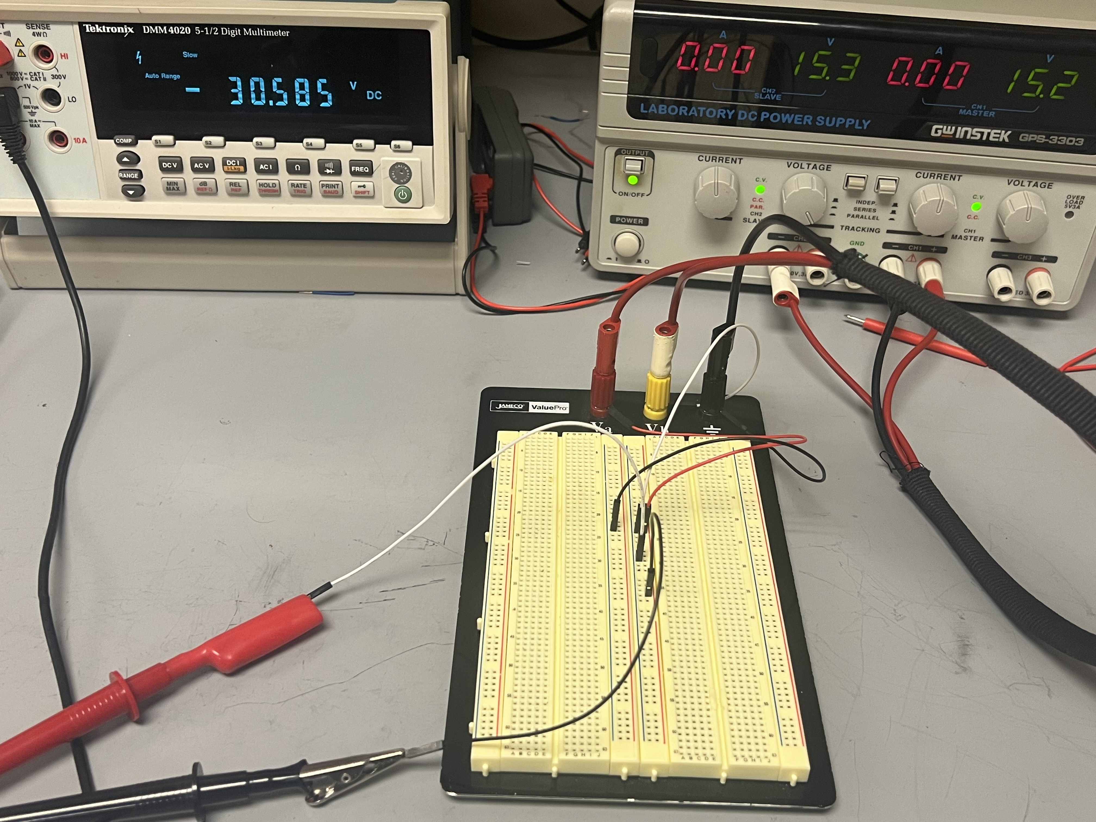
Example 3: Testing the connection of power source, breadboard, and multimeter
CH1(+) = 15V
CH1(-) = 0V
CH2(-) = -15V
Multimeter reading: CH2(-) – CH1(+) = (-15V) – (+15V) = -30V
* Yellow hat is connected to the white wire

Slide 6
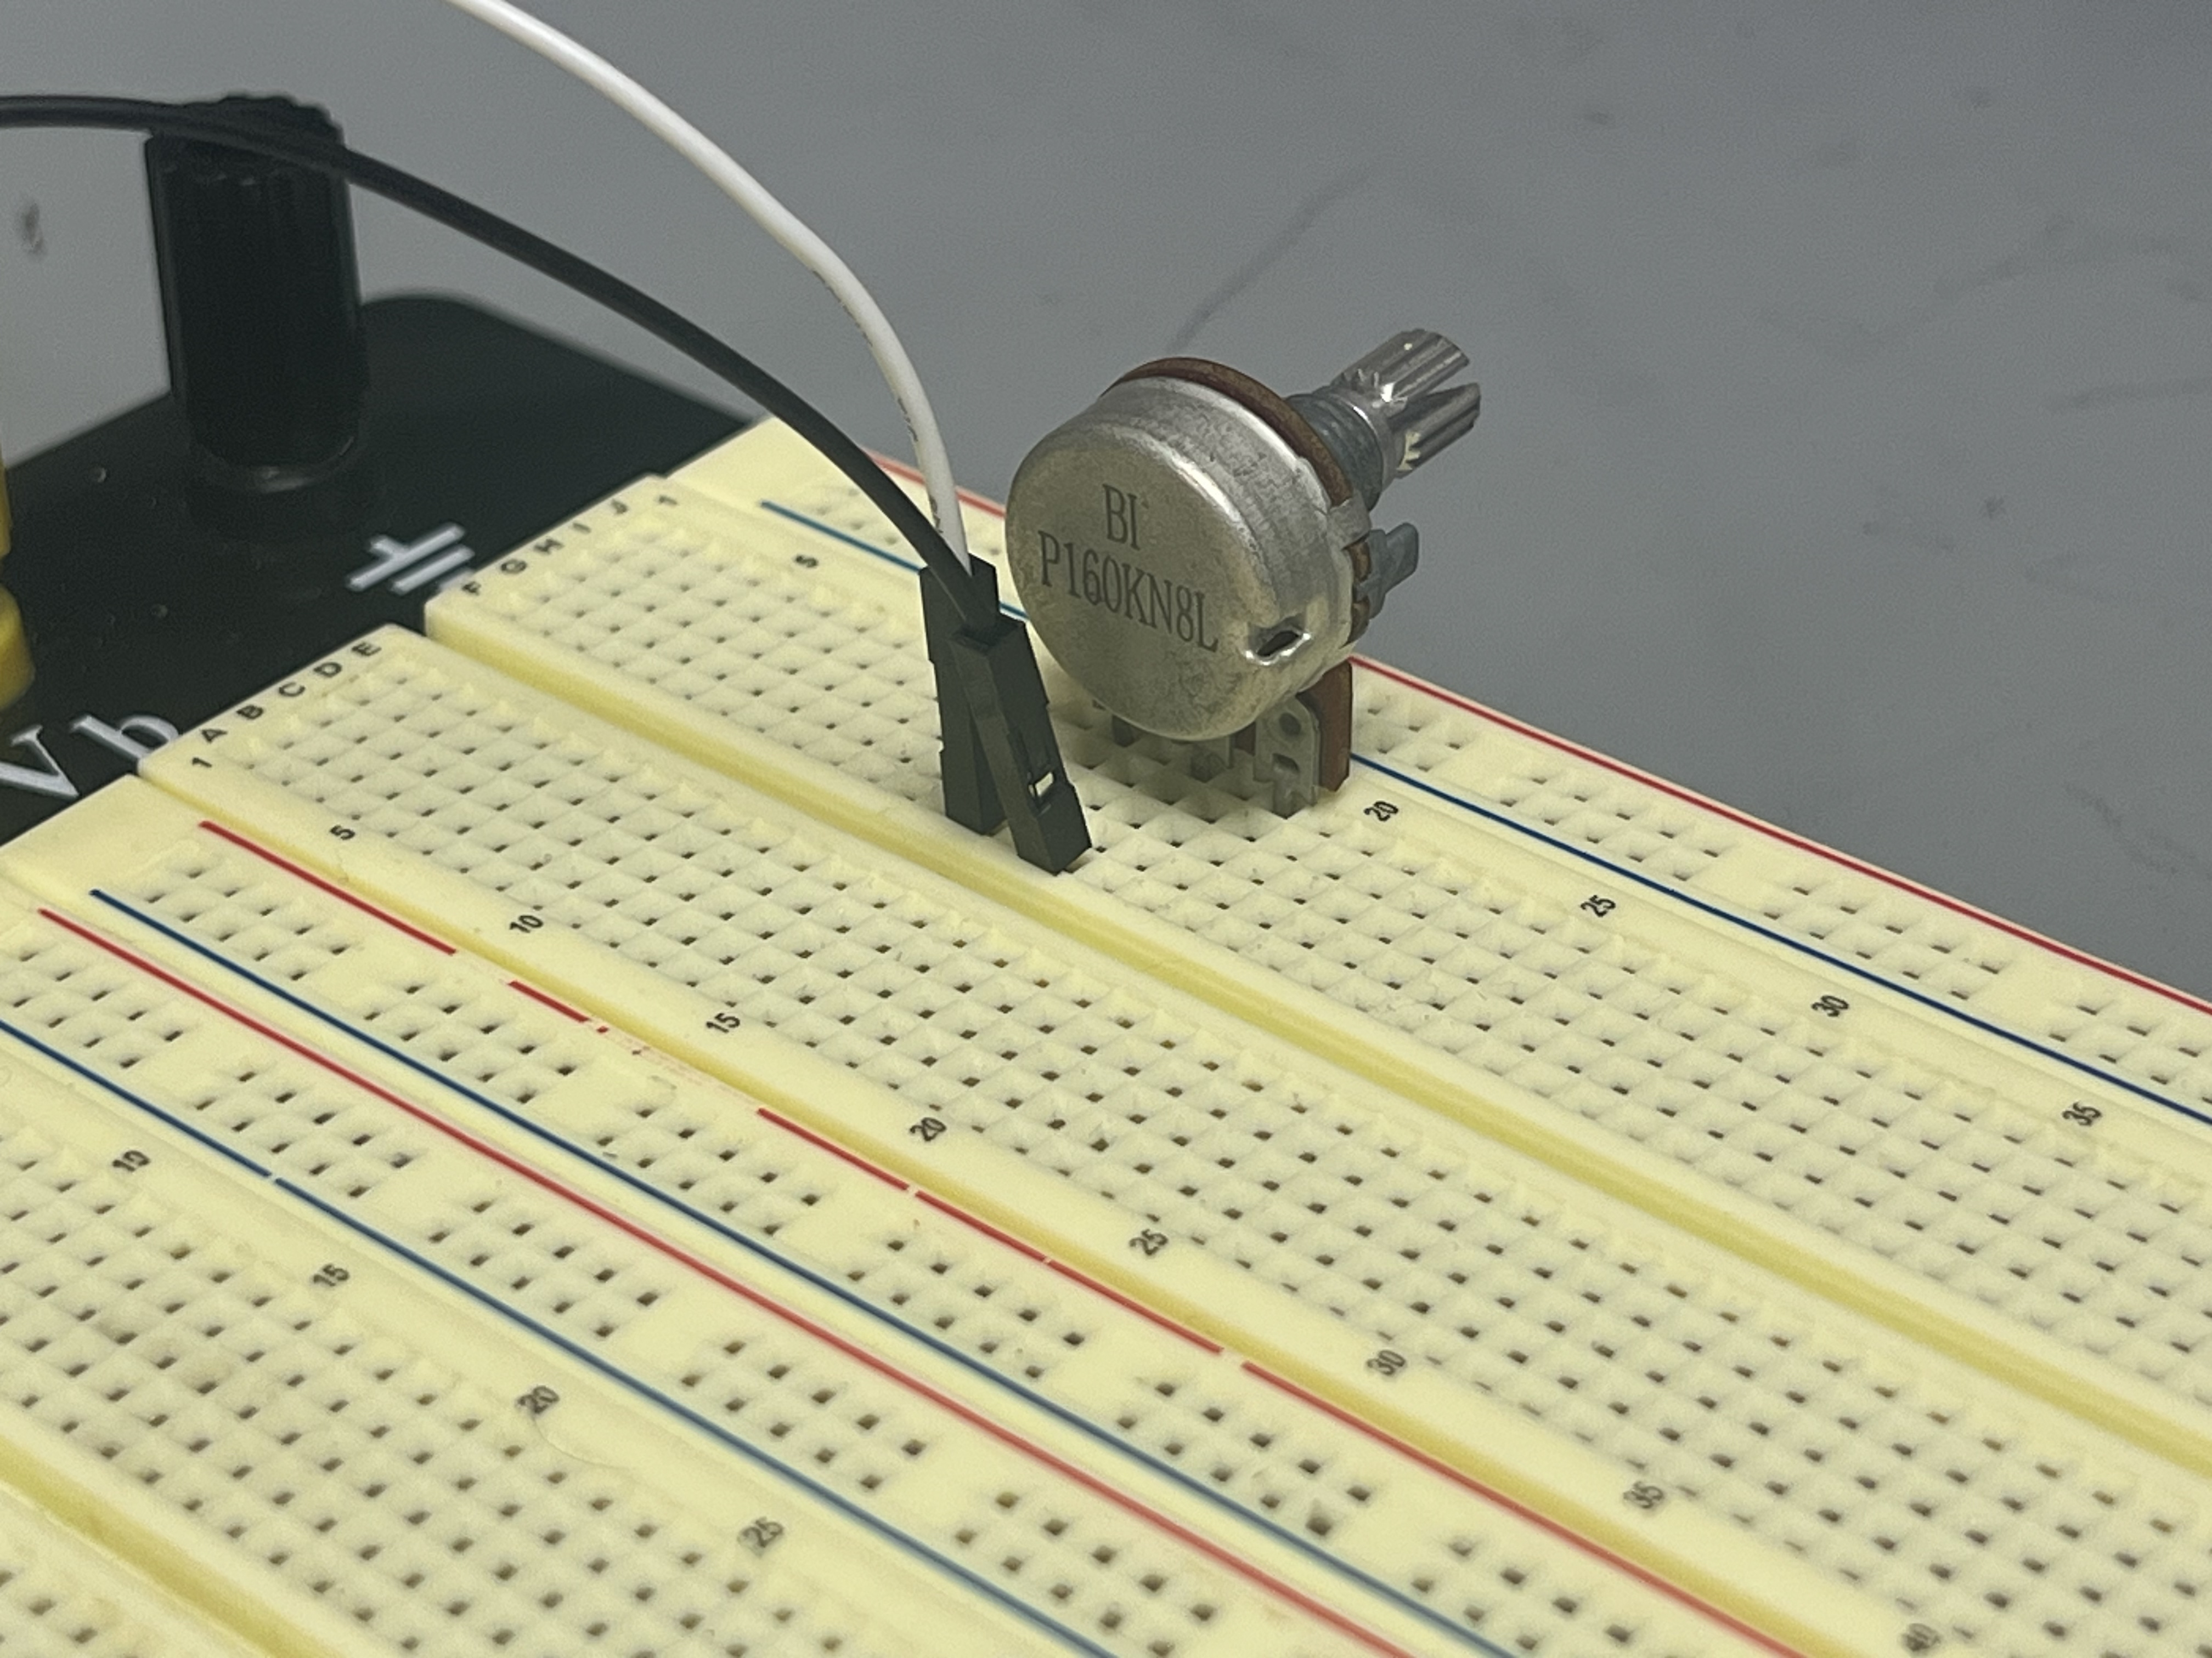
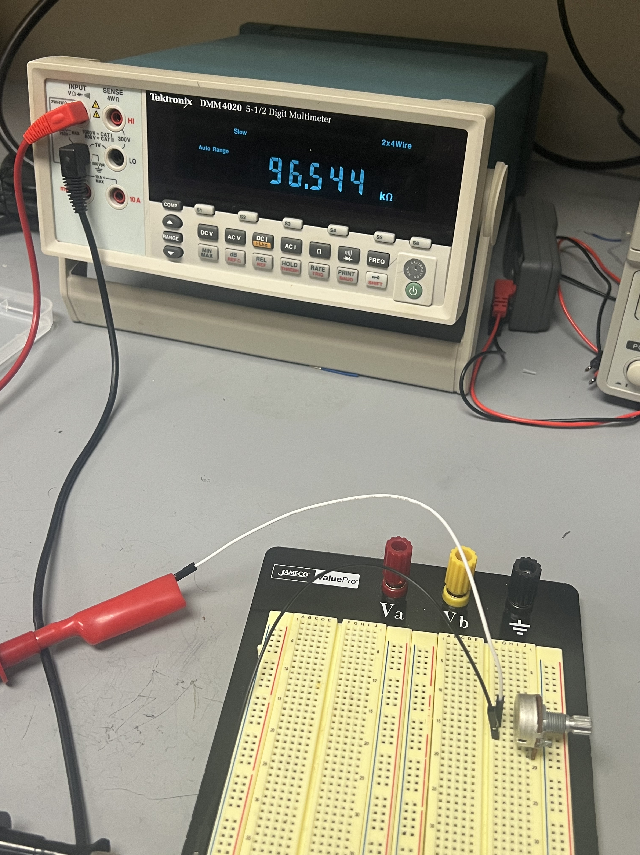
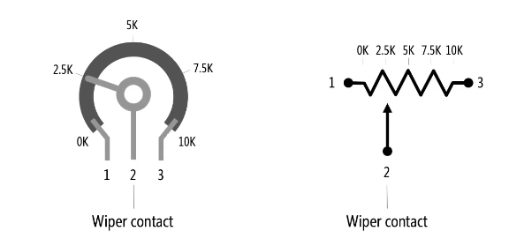
Example 4: Measuring the resistance of a potentiometer
Lead 1
Lead 2
Lead 3
Comments:
If lead 1 and 3 are connected to circuit, potentiometer is always connected with full range
If lead 1 (or 3) and 2 are connected, potentiometer is connected with varying resistance

